Slide 1
Forest growth models and new methods
Mikko Peltoniemi, Luke

Slide 2
Interests towards forest models
A wide range of interests towards quantified forest dynamics exist
Economical interests, often timber supply
Biodiversity
Carbon storage, from local to global levels
Nutrient leaching
Vulnerability and resilience
Etc …

Slide 3
Model complexity range, and some benefits
One leaf - Mean tree models
for homogenous canopies (e.g. CROBAS)
Cohort models (trees of different size in homogenous cohorts)
Allows including size-dependent competition, and differential development of different sized trees (e.g. MOTTI, PipeQual)
Often cohort NPP divided up into trees, which allocate it using some scheme
Gap-models: homogenous cohorts organised in space (4C, JABOWA)
Allows modeling some heterogenity of species and disturbances, gap formation, and regeneration

Slide 4
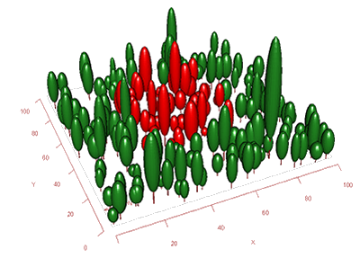
Model complexity range, and some benefits, cont.
Spatially explicit forest models (e.g. Sortie, Maespa)
Individual trees with location: allows explicit competition / mortality /regeneration description
Dispersal, …
light (bioclimatic) environment simulation
Canopy may be very simplistic
FSPM: + Detailed within tree and stand structure and physiology.
Other differiating features in models
Process comprehence and detail
Temporal resolution
Approach, process-based / empirical
http://maespa.github.io/

Slide 5
Model complexity range, and some benefits, cont.
Increasing detail of complexity allows simulating new things and wider facilitation of other research fields
In many occasion simple and effective descriptions of environment and dynamics are still desirable
Speed of calculations (e.g. global models)
Maintance of system
Increasing detail does not necessarily mean better statistical performance of models, and often contrary has been found

Slide 6
Schematic example of model complexity gains
Daily stand photosynthesis vs. eddy covariance GPP
Model complexity vs. uncertainty
But what was the innovation here?
Uncertainty of GPP
”Big-leaf” Two-leaf Multilayer Individual multilayer canopies

Slide 7
So why would we not get continuously decreasing trends?
Possible partial explanations
Data quality
Long testing / calibration tradition with simpler models
Limited knowledge on processes and feedbacks
”Big-leaf” Two-leaf Multilayer Individual multilayer canopies

Slide 8
New methods for identifying innovations?
The largest gains in previous examples were obtained when shade and sun leaf were separated
Can we inform simple models based on experiences with complex models?
What other innovations exist?

Slide 9
A look at literature: some old innovations and hypotheses used or could be used (in simpler) models
Functional balance (Davidson 1969)
The roots’ nitrogen uptake and shoots’ C uptake should be in balance
Scaling relationships, e.g. pipe model (Shinozaki et al. 1964) and derivatives
Mechanics of branch structure (McMahon 1973)
Steming from evolution theory
Plants should maximize their fitness (or fitness proxy)
Several studies exist where resources are spent optimally to sustain a function.
Optimal vertical N allocation (Sands et al., 1995, Badeck et al., 1995) + hydr. conductance (Peltoniemi et al 2012)
Allocation of C+N to maximize growth/NPP (Mäkelä et al.)
Community level responses:
self-thinning rules (Reineke, Yoda)
Distance to neighbours…
Etc…

Slide 10
Discussion topics?
How to transfer knowledge from complex ecosystems to models that serve practical scenario purposes?
Or how to generate useful tools from FSPM/lidar context?
Levels of required complexity of individual processes?
What are priority improvements needed?
How to use new methods in this
Identify new and verify old theories / innovations / hypothesis / emergent rules? …that operate at higher level
What kind of innovations / hypothesis / emergent rules are the most prospectful?

